Slide 1
Ship Cyber Security
Misuga Kaiun Group
3rd APR. 2025 Rev. 1.9

Slide 2
Agenda
What is Ship Cyber Security?
Types of Cyber Attacks
Malware Infection Process Diagram
Ship Cyber Security Policy
Roles and Responsibilities
Ship Cyber Security Manual & Plan
Sample Onboard Network Diagram
Antivirus Program
Rules, Regulations, & Protocols

Slide 3
What is Ship Cyber Security?
Ships rely more on digitization, digitalization, integration, and automation, which call for cyber risk management on board.
As technology develops, Information Technology (IT) and Operational Technology (OT) systems onboard ships are being networked together and more frequently connected to the internet.
This brings a greater risk of unauthorized access or malicious attacks to ships’ systems and networks.
Risks may also occur from personnel accessing these systems on board, for example, by transferring malware via removable media. (personal USB flash drives/external hard drives)

Slide 4

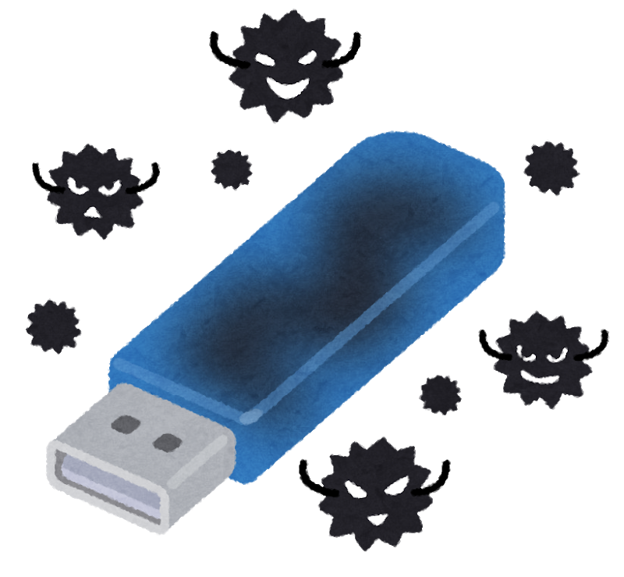

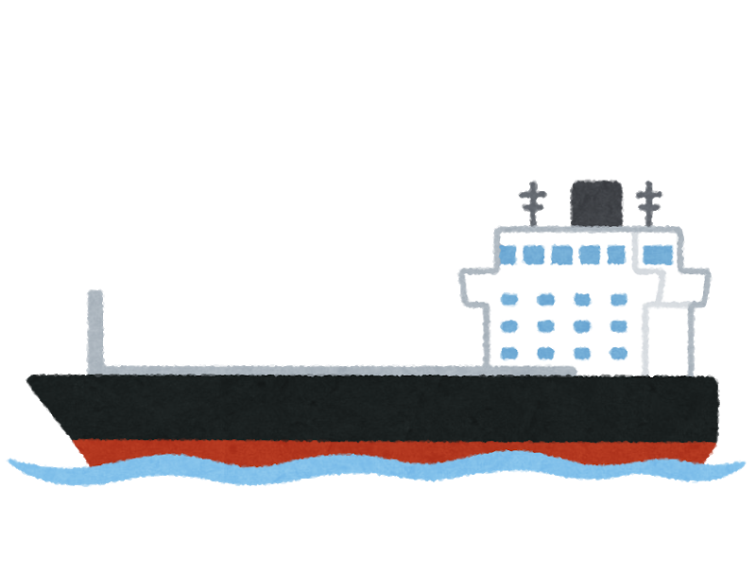




What is Ship Cyber Security?
Sample activities of hackers once they compromised the vessel’s onboard network.
Jamming of GNSS Malware Infection Spoofing of GNSS
(Email/Removable Media)
TRUE POSITION
MISS POSITION
*GNSS – Global Navigation Satellite System

Slide 5
Types of Cyber Attacks
Malware
→A malicious software designed to access or damage a computer.
【Types of Malware】
Viruses→Small program or script that infect systems or networks. Can create, move or erase files.
Worms→Similar to viruses but designed to infect multiple systems or computers.
Trojan→Disguises itself as legitimate software but designed to retrieve sensitive data.
Spyware→Spies on a computer and can capture information such as (web browsing habits, emails, usernames, passwords and credit card information)
Pop-up Ads (Adware)→Appear in their own window in a browser that contains malware.
Browser Hijacker→Infects a computer via adware and make changes to browser’s settings.
Ransomware→Encrypts data so that files cannot be accessed.

Slide 6
Types of Cyber Attacks
DDoS (Distributed Denial of Services)
Aim to overload a network by sending a huge number of data requests to that network.
This causes it to crash or slow down significally.
It can affect all devices connected to an infected network.

Slide 7
Types of Cyber Attacks
Social Engineering
→Deliberate manipulation of people to gain unauthorized access to data, applications or systems.
【Types of Social Engineering】
Phishing→Spam emails (often sent to a large number of recipients at random) Often contain infected links or attachments and often used to gain entry to networks. By infecting the receiver, a gateway into their network is created to infiltrate the system.
Spear Phishing→Same with phishing but directed at a specific individual or company. Uses personalized information to increase the success of attack.
Spoofing→Involves misdirection to a website that is pretending to be a legitimate website or visiting a website that has being hijacked.
Man-in-the-Middle (MITM) Attacks→An attacker secretly relays (and often alters) communication between two parties who believe they are communicating directly with each other.

Slide 8
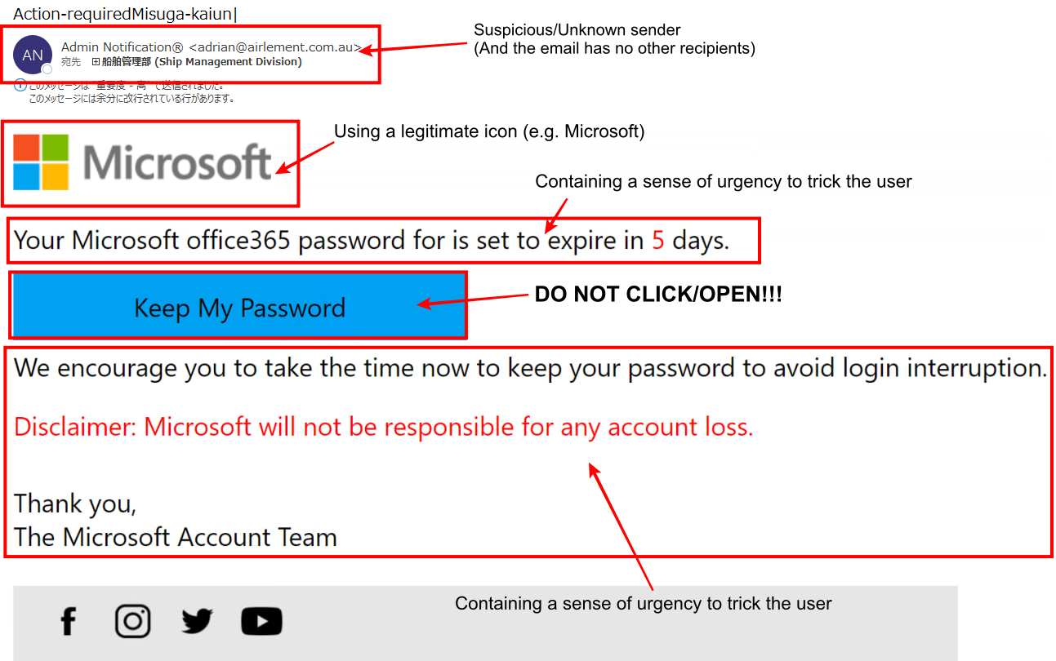
Types of Cyber Attacks
Sample SPAM/Phishing Email

Slide 9
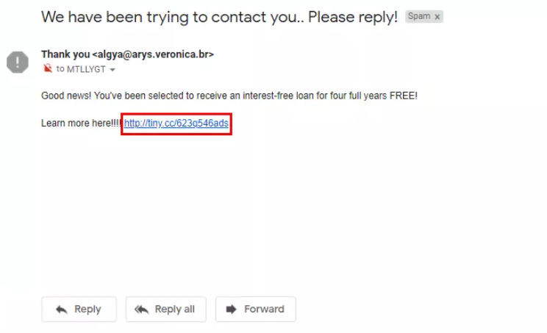
Types of Cyber Attacks
Sample Malicious URL/Links

Slide 10
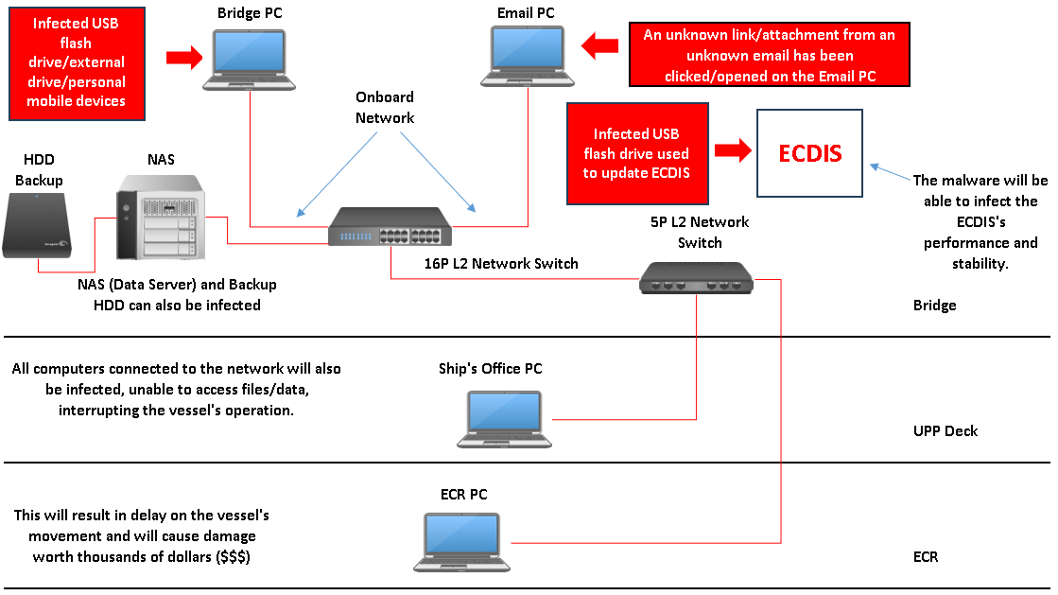
Malware Infection Process Diagram

Slide 11
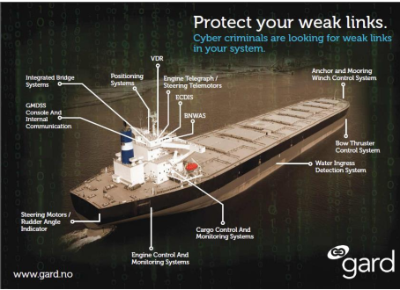
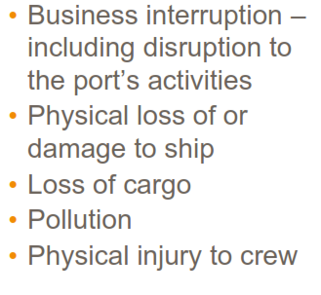

Slide 12
Ship Cyber Security Policy
Misuga Kaiun’s ship cyber security policy is to provide a secure working environment, by establishing and maintaining the required cyber security measures to prevent unlawful acts and mitigate cyber risks which may endanger the safety and security of all personnel and property engaged in its business activities.

Slide 13
Ship Cyber Security Policy
ALL CREW ARE “STRICTLY PROHIBITED” TO:
Connect any personal USB flash drives/external hard drives to any onboard IT & OT Systems.
Transferring of files to the ship’s computers using personal devices.
Install any “ILLEGAL”, “UNAPPROVED”, or “NON-WORK-RELATED” software/applications.
Bringing personal satellite communication devices.
Changing the designated location of onboard computers.
Modifying the onboard computers’ default settings.

Slide 14
Roles and Responsibilities
・CCySO (Company Cyber Security Officer):
IT Planning Division (Ship ICT)
(This includes all the locations below)
SHIKOKU
TOKYO
PHILIPPINES
HOLLAND
・SCySO (Ship Cyber Security Officer):
Master/Captain

Slide 15
Roles and Responsibilities
・SCySO Duties and Responsibilities shall include but not be limited to:
Overall, in charge of ship cybersecurity-related matters and liaison with CCySO.
Implement, review, and maintain Ship Cyber Risk Management Plan.
Carry out an initial assessment of any suspected incident.
Implement "Cyber Risk Management Basic Policies“ (Including training).
Report any ship cyber security breaches (actual or suspected).

Slide 16
Ship Cyber Security Manual & Plan
E-Mail Etiquette
Communication through E-mail or messaging services shall be conducted professionally, and the use of vulgar or obscene language is prohibited.
Private information shall not be revealed unless formally instructed by the company.
All communications shall be sent only to those concerned and CC shall be managed with utmost care.
Communications transmitted through company networks and systems are the property of the company, therefore it may be subjected to review and inspection.
All outgoing business communication from the ship via Internet and E-mail shall be approved by the Master beforehand.

Slide 17
Ship Cyber Security Manual & Plan
General cautions in handling E-mails:
THINK BEFORE YOU CLICK!
Do not respond to emails from unknown senders/sources.
Do not click links or open attachments of any kind from unknown senders/sources.
Received suspicious/unknown emails should be reported immediately to the CCySO for verification.
Instructions from the CCySO will be provided to the vessel once the suspicious/unknown email has been checked and verified.
Master shall take weekly backups of e-mails, or earlier if specified by the Company.

Slide 18
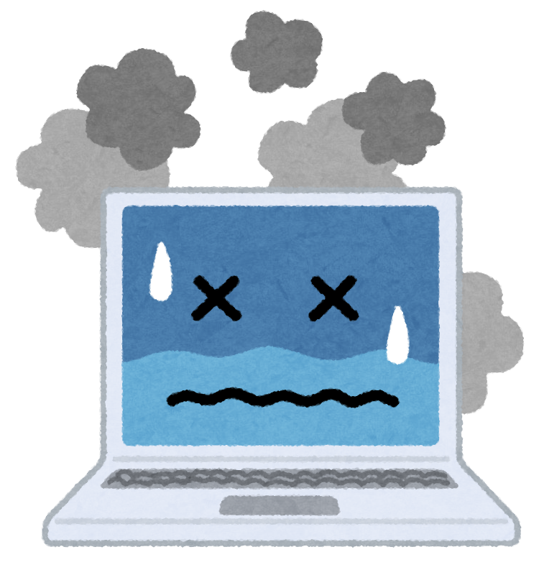



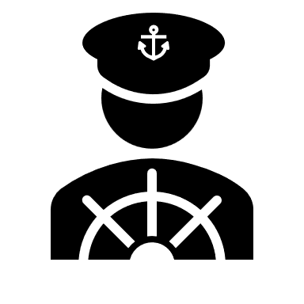
・Report to the CCySO for any Ship ICT related issues.
Ship Cyber Security Manual & Plan
Quick Report
SCySO
CCySO

Slide 19
For any IT System-related issues, the Master shall report them to the CCySO: - For urgent matters, CCySO can be contacted via phone. - IT System-related issues shall be treated as “URGENT” and to be reported immediately: >Satellite communication system issues (VSAT, FBB, CERTUS, STARLINK.) >E-mail communication issues >Loading software issues >Nautical publication and correction software issues >Weather Routing System issues >ABLOG issues >WRH5 issues - Detailed status of the problem including screenshots shall be submitted for CCySO’s reference. - Refrain from self troubleshooting on ICT-related issues regardless of its severity and contact the Ship ICT for assistance.
Ship Cyber Security Manual & Plan

Slide 20

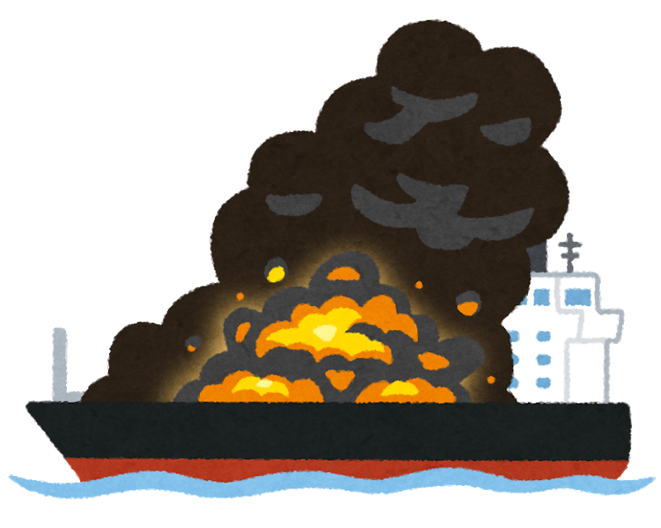



・Social Media Usage during Emergency
Ship Cyber Security Manual & Plan
Emergency Head Quarter
Allowed
The right to discontinue its use as deemed necessary

Slide 21
As a general rule, the use of Social media by the crew during an emergency is allowed, however, under prevailing circumstances, the Head Office Response Team (Emergency Head Quarter) reserves the right to discontinue its use as deemed necessary. In addition, to the above golden rules following shall be complied with: Never post any information related to the emergency if not formally instructed by the EHQ.
Ship Cyber Security Manual & Plan

Slide 22
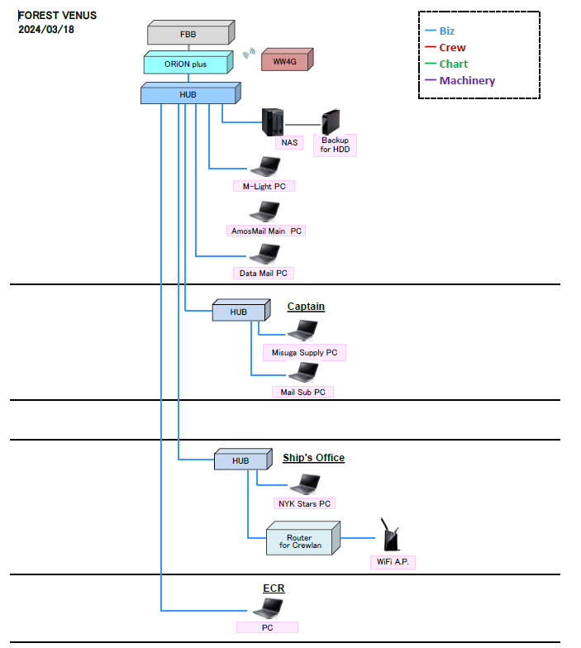
SAMPLE ONBOARD NETWORK DIAGRAM

Slide 23
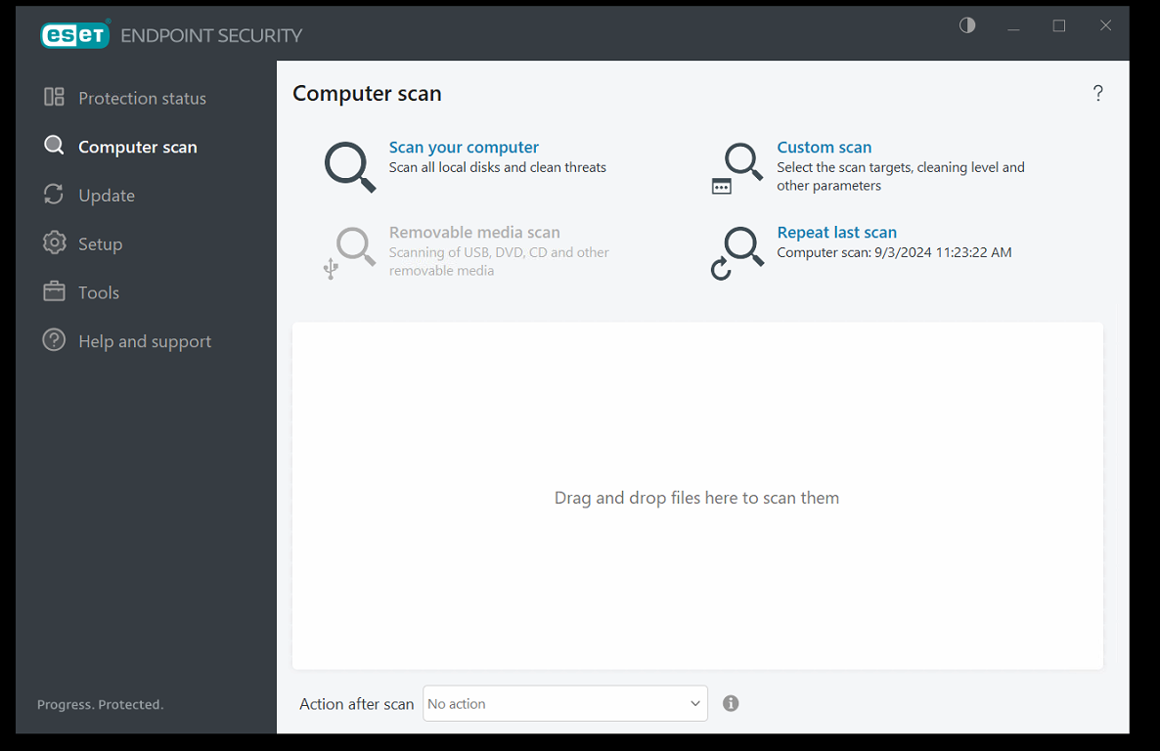
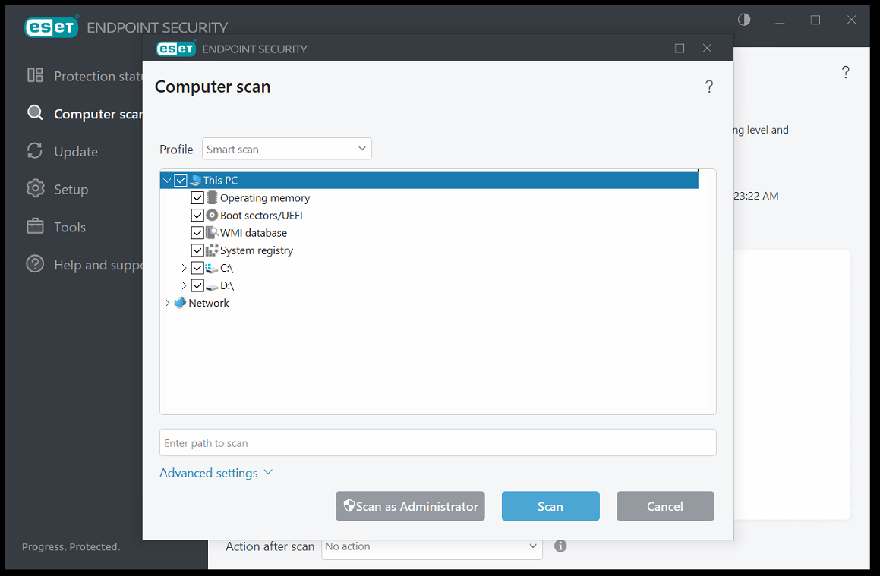

Antivirus Program
ESET is the official Antivirus Program of the company’s entire fleet.
All computers connected to the onboard network should be scanned with this application once a week and provide the results to the CCySO for reference.
Updates will commence automatically once an active network has been detected.

Slide 24
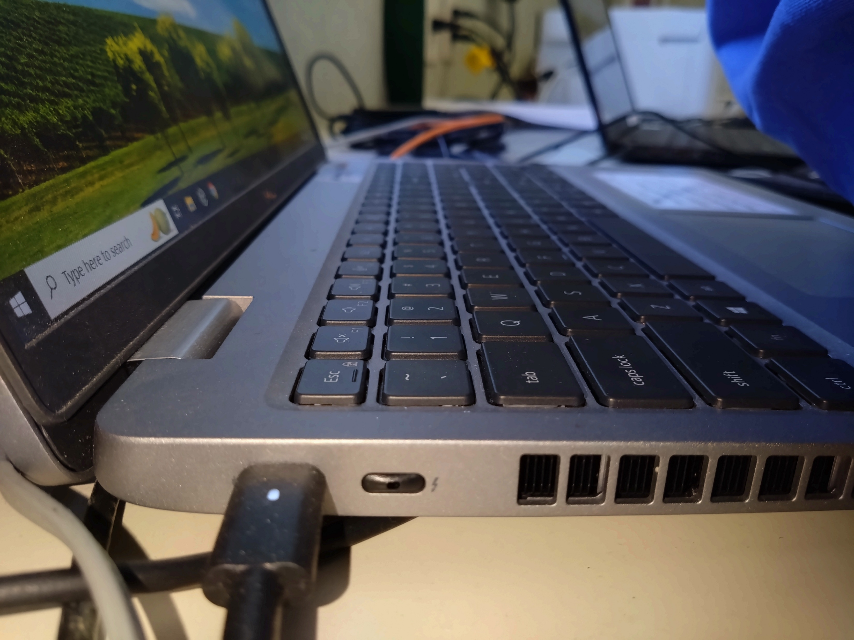
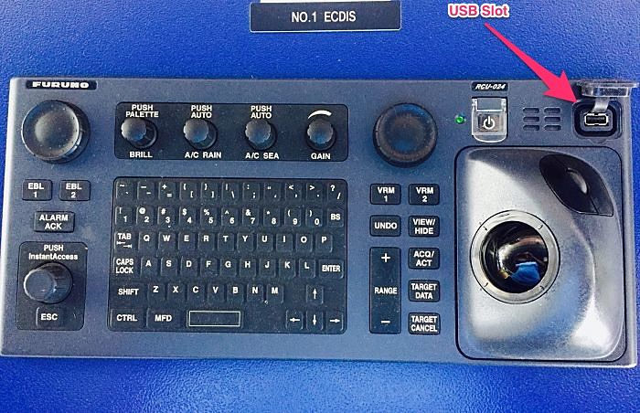
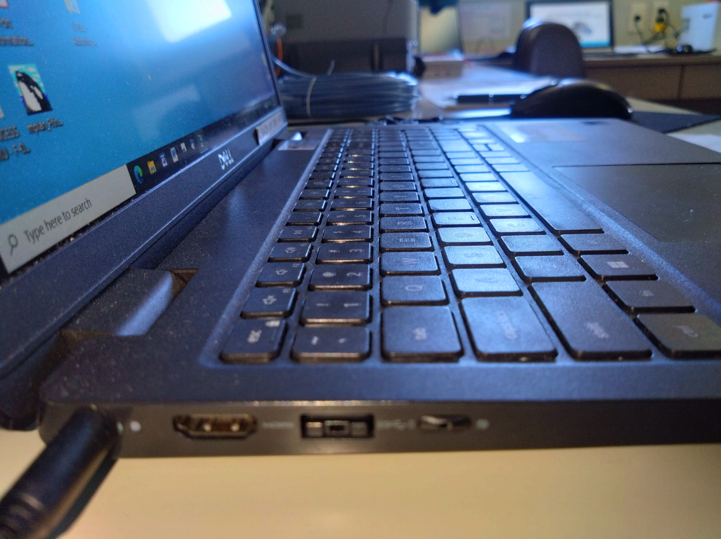
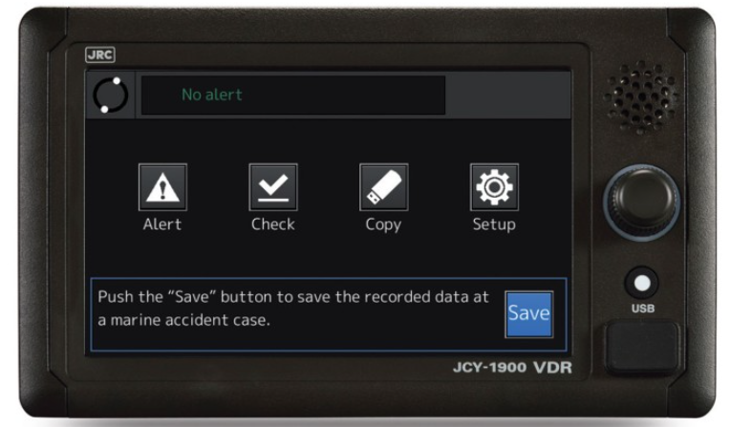
Rules, Regulations, Protocols
USB Port Blockers must be installed on the available ports of IT & OT devices.

Slide 25
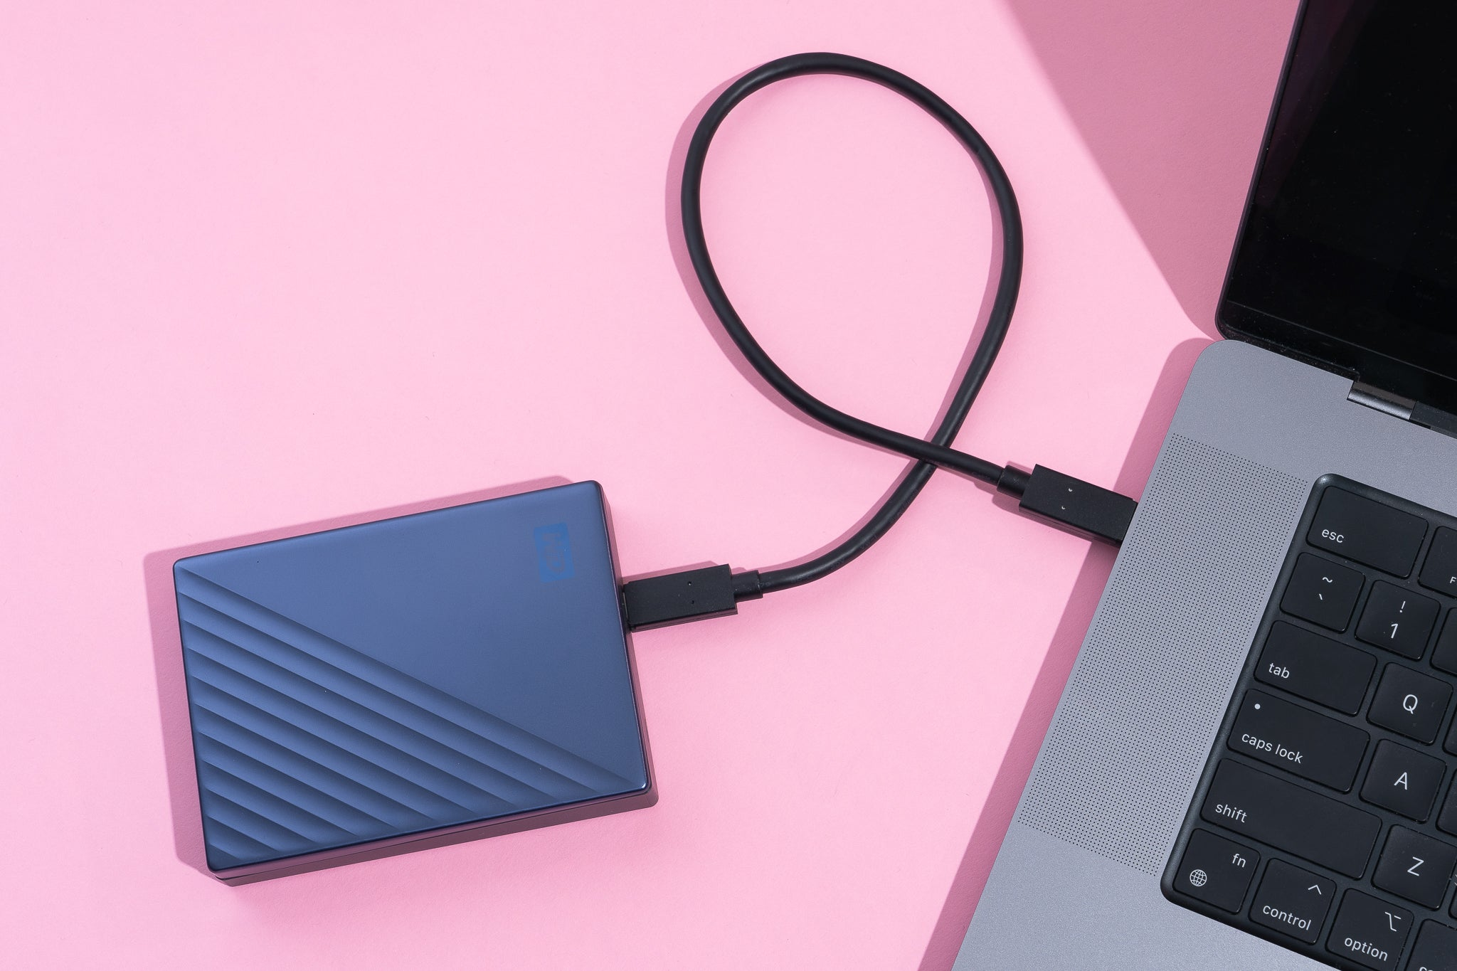
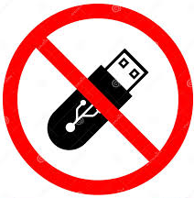

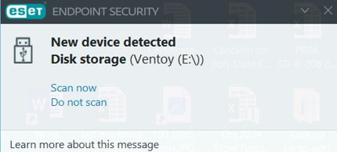
Rules, Regulations, Protocols
Connecting any personal USB flash drives/external hard drives on the vessel's IT and OT systems is strictly prohibited.
However, in case that the said media is necessary for 3rd parties' operations, the SCySO (Master) should check it first by scanning it for malware/viruses before opening it on onboard computers. (Ensure that ESET is already updated before scanning)
MUST!!!

Slide 26
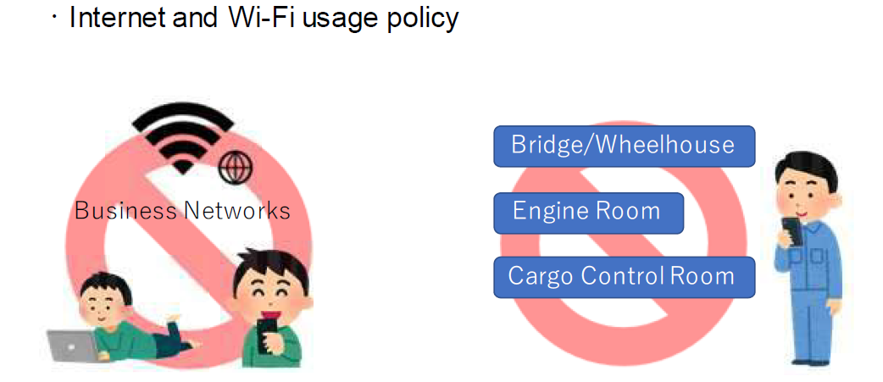



Rules, Regulations, Protocols
Prohibit on using the business network for personal use. (Accessing unauthorized sites and downloading unauthorized files or media)
This must be systematically monitored so that the perpetrator can be identified.
Please be informed that this is a “Serious Compliance Violation”
The misconduct will be recorded in the boarding history of those who have violated it.

Slide 27
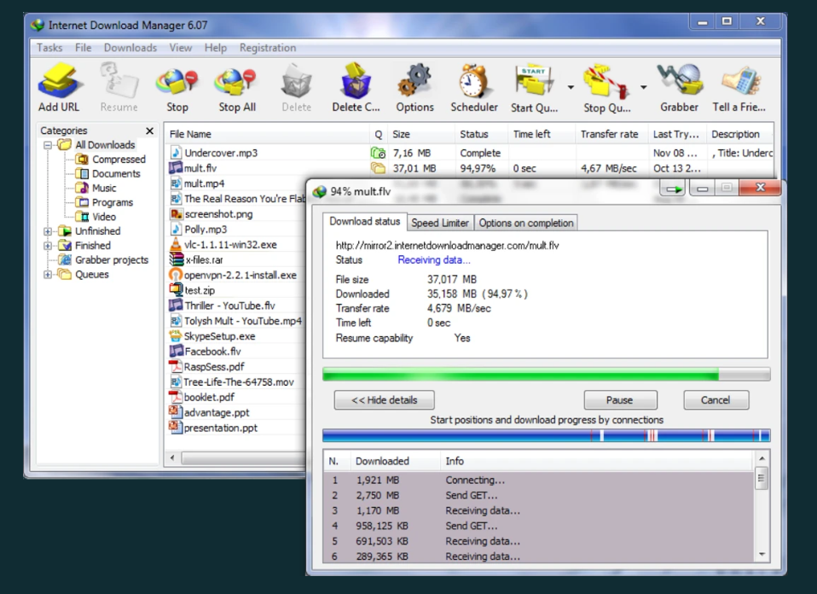

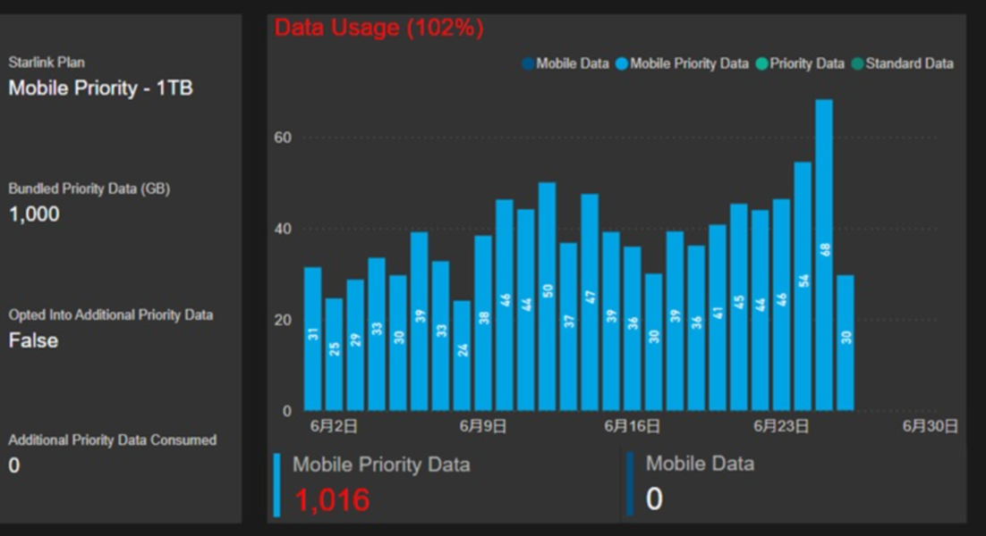

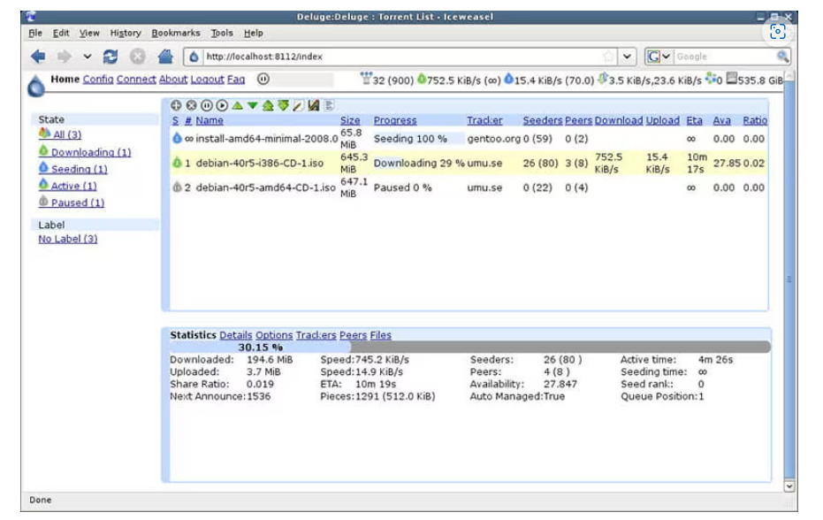
Rules, Regulations, Protocols
There was an incident in one of our vessel’s business networks that was later used for personal purposes and consumed up to 60 GB of data in one day. (based on the above graph)
Unauthorized access from the “Business Network” to the video service platform “YOUTUBE” (and other unauthorized sites and downloads) was later discovered. As the crew discovered that internet access was possible on that computer, instead of informing the SCySO, they continued to use it until it was later found by the management that the monthly data limit had been exceeded due to this activity.
Consuming that high amount of data per day is not rational in the vessel’s everyday operation, We confirmed that it is being used for personal activity, and this is a very serious compliance violation.

Slide 28




Rules, Regulations, Protocols
Do not connect personal devices such as personal computers, mobile phones, or tablets to the vessel’s business network or onboard computers. (Wi-Fi or LAN)
Bringing or using personal satellite communication devices such as “Personal Starlink Device” is prohibited.
The use of “Bluetooth” and “MicroSD” are also prohibited,
If the vessel’s digital camera or any other device officially provided by the company is broken, report it to the company to provide a new one. Do not use personal devices for taking photos and transferring them to the vessel’s business computers.

Slide 29





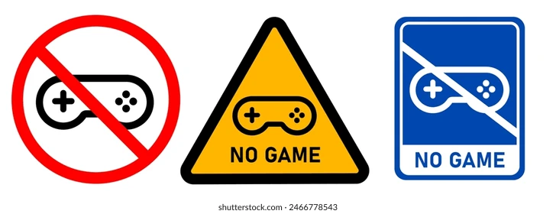
Rules, Regulations, Protocols
Do not modify the default system settings, install unauthorized, non-work-related applications, download non-work-related files, or create unauthorized connections using the onboard computers and network (Mobile hotspots)
Other actions, such as the unauthorized installation of apps and downloading non-work-related files/data will also be monitored. If any of these are found, they will be deleted without notice, and the SCySO will be informed regarding these findings afterward.

Slide 30
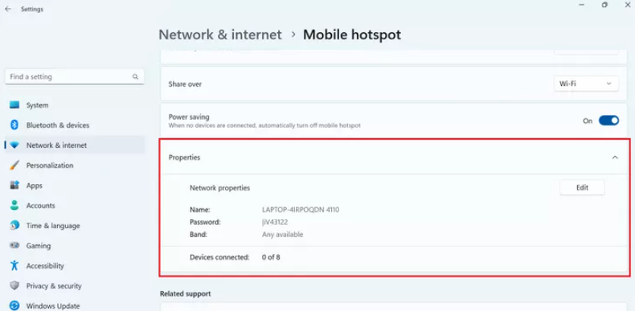
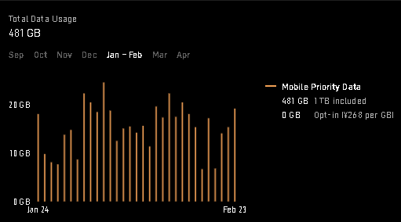
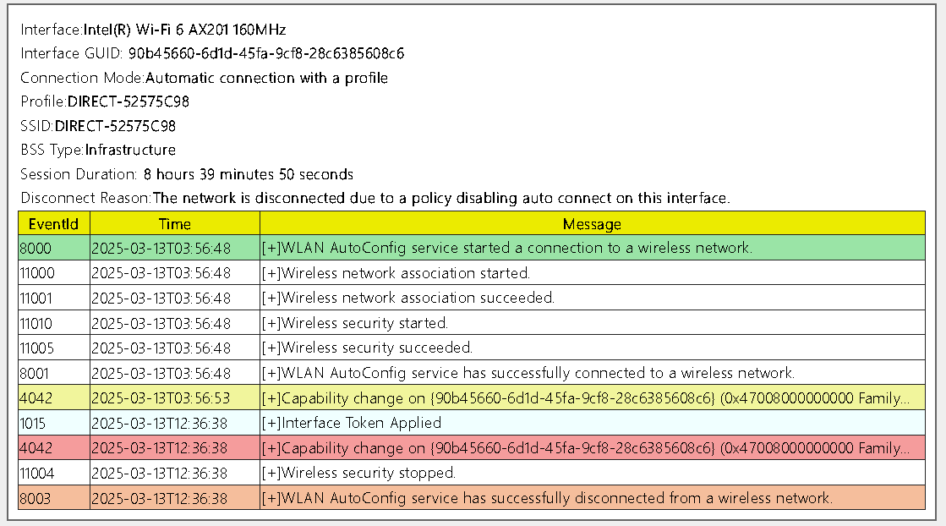



Rules, Regulations, Protocols
Another incident in which some crew members have some technical knowledge regarding computers. They modify the onboard computer’s LAN connection and share its business network connection via Wi-Fi, creating a “Mobile Hotspot” that can connect their personal devices via Wi-Fi connection and without directly accessing unauthorized sites from onboard computers.
This activity is also a “Very Serious Compliance Violation” on our Ship Cyber Security Compliance.

Slide 31
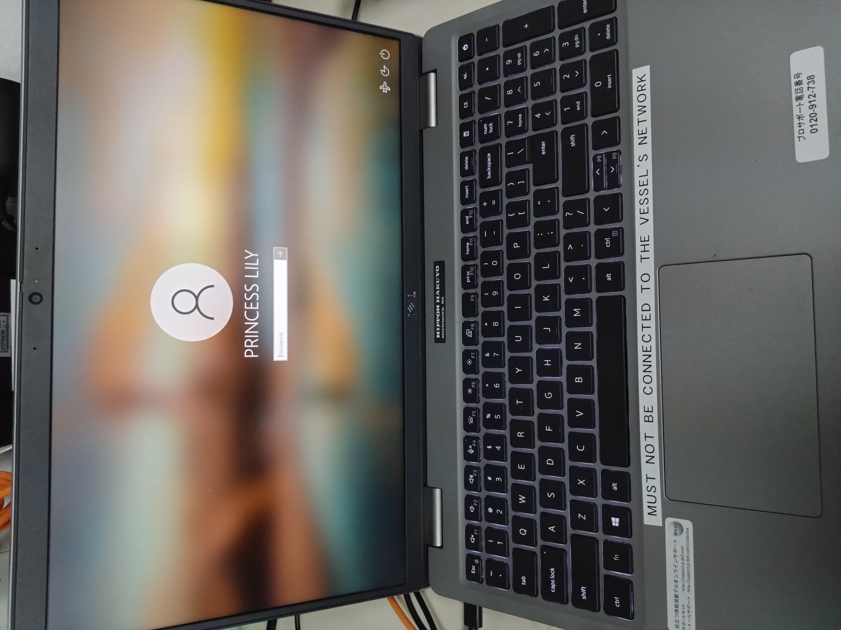
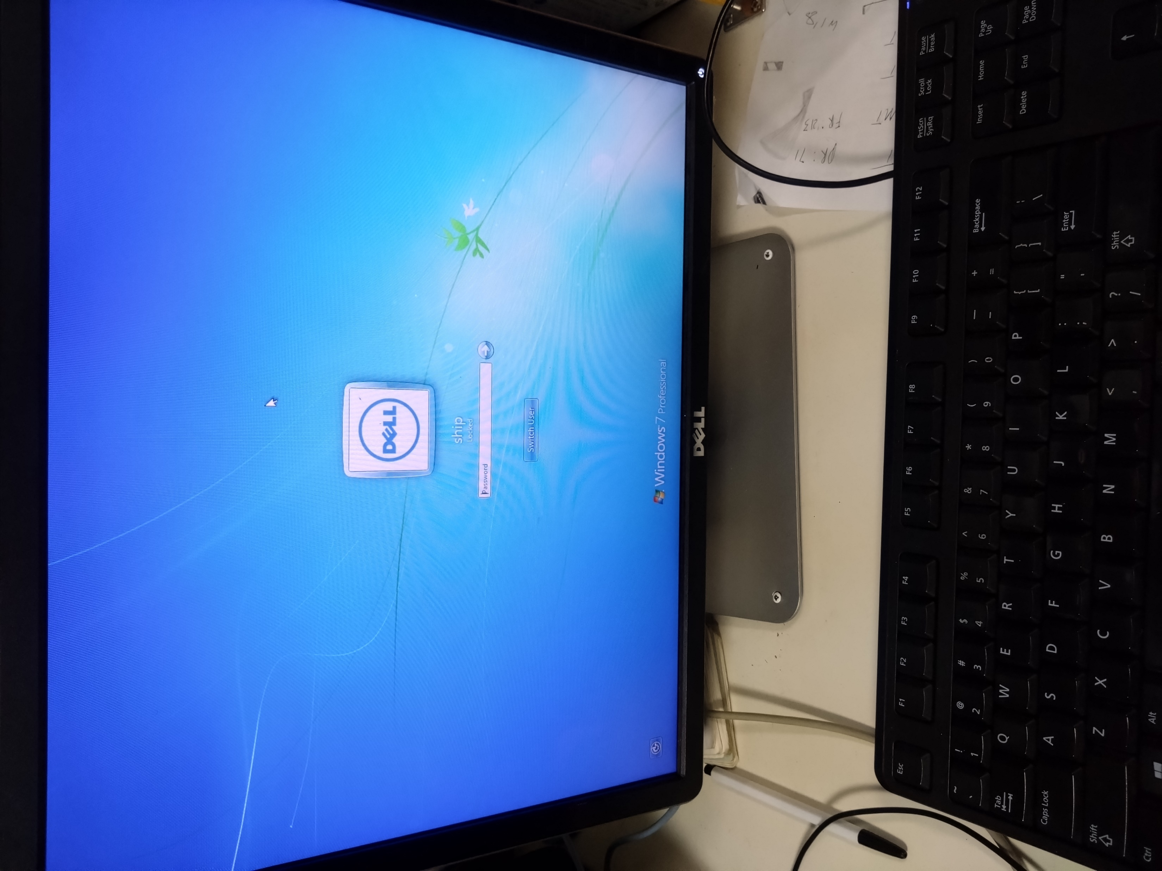
Rules, Regulations, Protocols
Do not connect the LOADCOM (Loading Computer) to the vessel’s network. (This is strictly prohibited)
The LOADCOM should only be used as a stand-alone system on the vessel and act like a calculator.

Slide 32
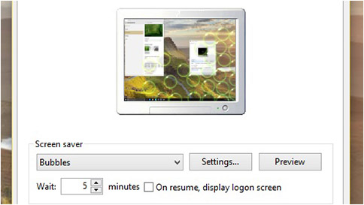
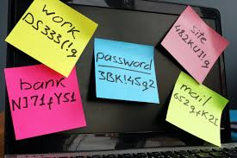
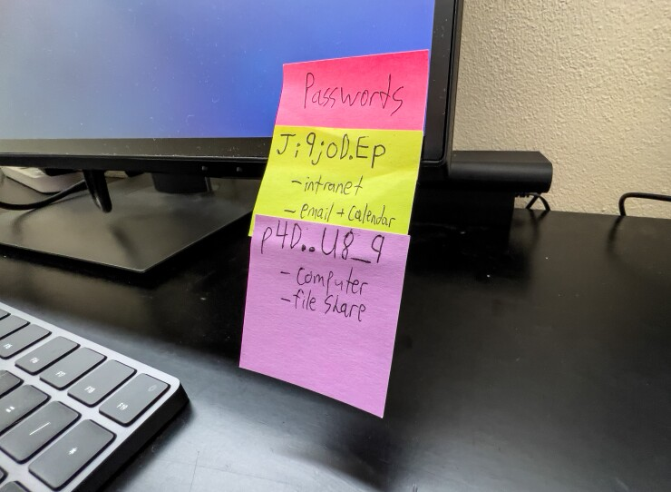
Rules, Regulations, Protocols
All computers shall be password-protected to prevent 3rd parties from viewing sensitive information inside the vessel’s onboard computers.
All computers’ screensavers shall be set to 10 minutes and the “display logon screen” must be checked.
Do not post passwords on visible places (desks, walls, in front of the monitor)
IT & OT system users with access privileges shall not share passwords or allow others to use their accounts.

Slide 33
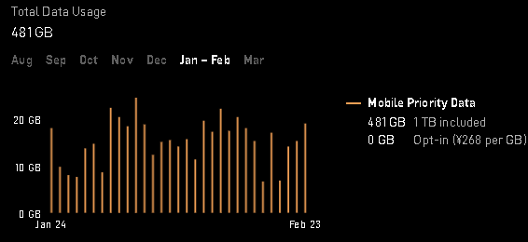

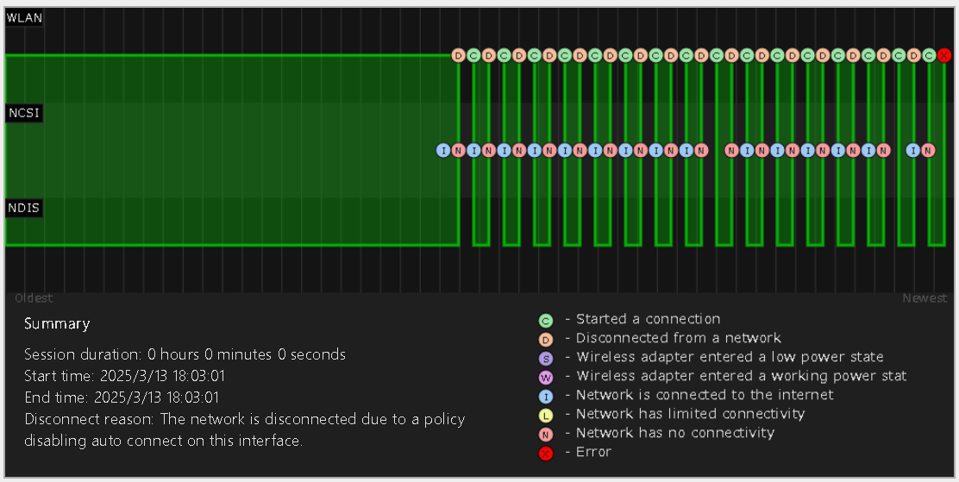
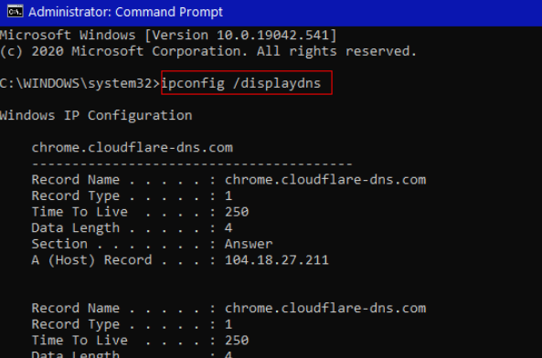
Rules, Regulations, Protocols
Please be informed that we are strictly analyzing and monitoring every Ship ICT-related activity on the vessel’s onboard network.
SHIP ICT

Slide 34
Rules, Regulations, Protocols
All the above rules, regulations, and protocols should be followed.
Violating the above rules will result in a “Serious Compliance Violation”.

Slide 35
For any Ship-related issues or requests, kindly contact the “Ship ICT” to provide assistance.
ship_it@misuga-kaiun.co.jp

Slide 36
THANK YOU!

